Slide 1



Cloud Native Workshop
Spring Boot and Actuator
Pivotal Cloud Foundry
Notes:
I want to talk to you about cloud native applications, and bringing microservice architectures into production in the enterprise.

Slide 2
Agenda
Why Spring?
Why Spring Boot?
What’s New in Spring Boot 2.0

Slide 3
Why Spring?
Removing Boilerplate
Testability
Type Conversion

Slide 4
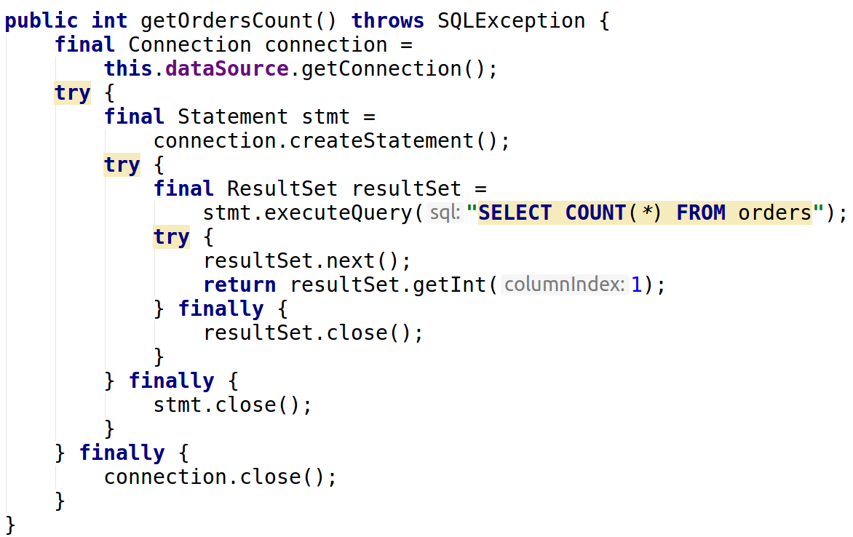
Remove Boilerplate

Slide 5
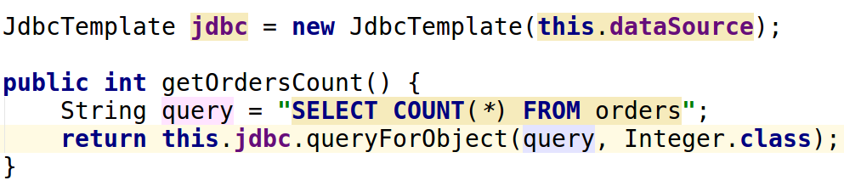
Remove Boilerplate

Slide 6
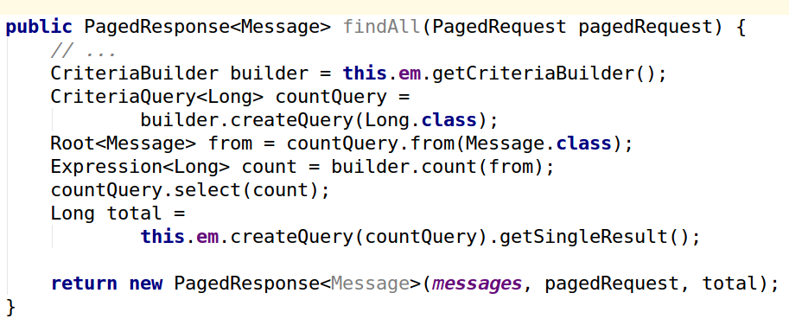
Remove Boilerplate
Notes:
Still have not implemented sorting
Even longer with queries that contain Predicate instances
Could create generic DAO
What about our custom queries?
What about non-relational databases?

Slide 7
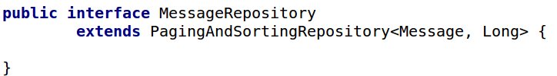
Remove Boilerplate

Slide 8
Agenda
Removing Boilerplate
Testability
Type Conversion

Slide 9
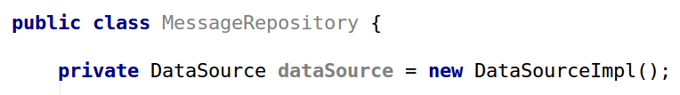
Testability
Notes:
How do we test this?
How do we externalize our configuration of connection url, username, password, etc?

Slide 10
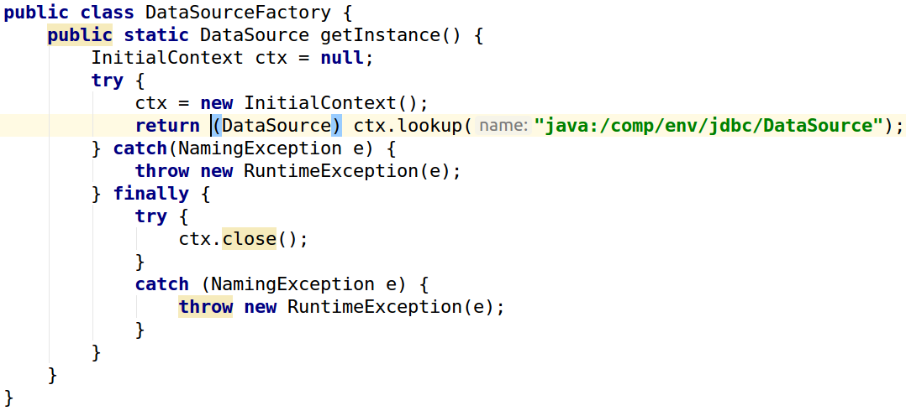
Testability

Slide 11
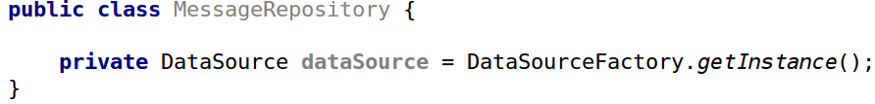
Testability
Notes:
Now we can configure it, but how do we test?
If we cannot easily test it means that we cannot really run anywhere. How run in the cloud?
Let’s use inversion of control. The dependency is now pushed in vs pulled in.

Slide 12
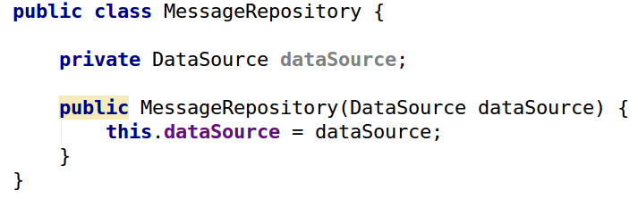
Testability
Notes:
Now MessageRepository can work with any implementation of DataSource and it can be obtained from anywhere.

Slide 13
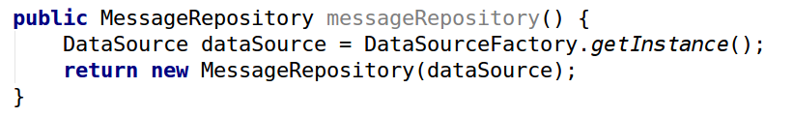
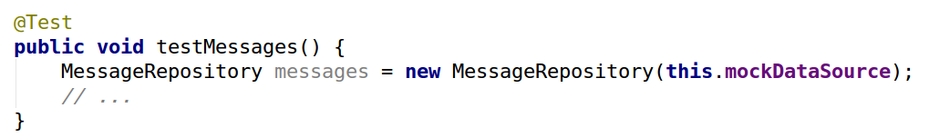
Testability
Notes:
Now we can configure it, but how do we test?
If we cannot easily test it means that we cannot really run anywhere. How run in the cloud?
Let’s use inversion of control. The dependency is now pushed in vs pulled in.

Slide 14
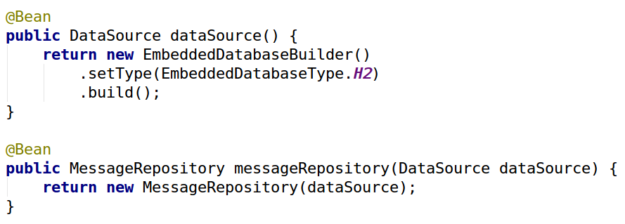
Testability
Notes:
Makes writing good code easy
Since Spring creates everything it can use AOP to weave in aspects for things like transaction management, security, and more

Slide 15
Agenda
Removing Boilerplate
Testability
Type Conversion

Slide 16
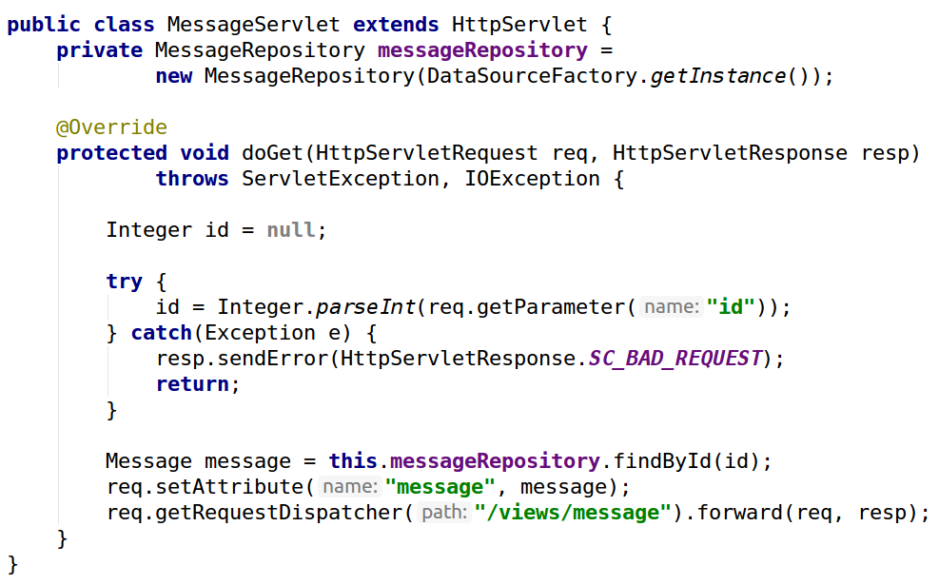
Type Conversion
Notes:
How works in a traditional Servlet World

Slide 17
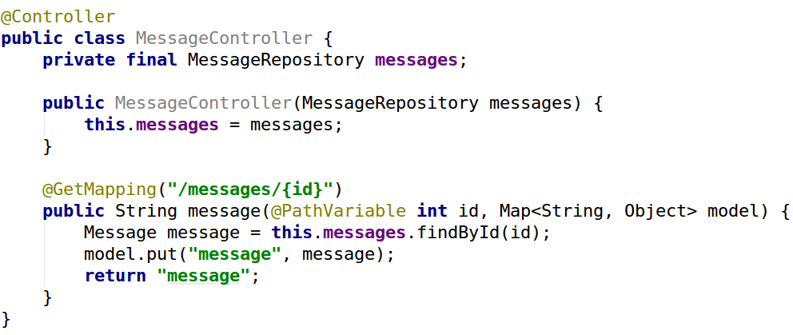
Type Conversion
Notes:
Readable - no conversion
Testable - resolve MessageRepository externally which means we can test w/ any implementation, no dependency on HttpServletRequest/Response (or Spring for that matter)

Slide 18
Cloud Native Workshop
Spring Boot and Actuator
Pivotal Cloud Foundry
Notes:
To be cloud native it needs to run anywhere how can we do that if we rely on factories (especially ones that only live in certain contexts and are configured differently in different environments).
A goal of cloud native is to be faster (remove boilerplate)

Slide 19
Why Spring Boot?
Dependency Management
Stand-alone Spring Applications
Conventions
Production-ready features

Slide 20
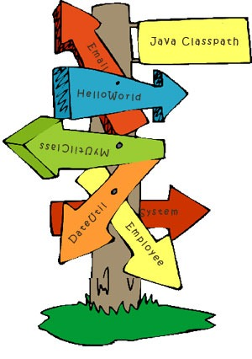
Classpath Hell
Jar versions do not work together
What Jars do I need?
Adding a Jar breaks other libraries
Notes:
If I want a web application, which jars do I need?

Slide 21
Spring Boot Starters
Groups dependencies by concept
Manages dependency versions that work together
Excludes libraries you don’t need
Notes:
excludes - commons-logging for slf4j and logback

Slide 22
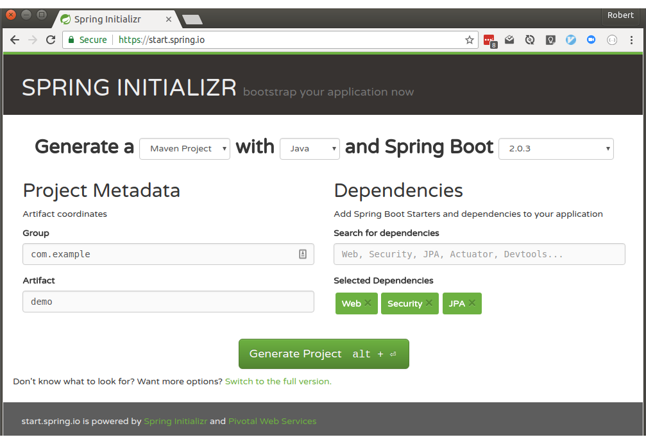
Spring Initializr
Notes:
Can also use command line and IDEs like IntelliJ and Eclipse
Provides the maven pom with the correct dependencies for you (i.e. spring-starter-web)

Slide 23
Why Spring Boot?
Dependency Management
Stand-alone Spring Applications
Conventions
Production-ready features

Slide 24



Stand-Alone Spring Applications

Slide 25
Stand-Alone Spring Applications
$ mvn spring-boot:run . ____ _ __ _ _ /\\ / ___'_ __ _ _(_)_ __ __ _ \ \ \ \ ( ( )\___ | '_ | '_| | '_ \/ _` | \ \ \ \ \\/ ___)| |_)| | | | | || (_| | ) ) ) ) ' |____| .__|_| |_|_| |_\__, | / / / / =========|_|==============|___/=/_/_/_/ :: Spring Boot :: (v2.0.3.RELEASE) ....... . . . ....... . . . (log output here) ....... . . . ........ Started Example in 2.222 seconds (JVM running for 6.514)

Slide 26
Stand-Alone Spring Applications
$ mvn package ... $ java -jar target/myproject-0.0.1-SNAPSHOT.jar . ____ _ __ _ _ /\\ / ___'_ __ _ _(_)_ __ __ _ \ \ \ \ ( ( )\___ | '_ | '_| | '_ \/ _` | \ \ \ \ \\/ ___)| |_)| | | | | || (_| | ) ) ) ) ' |____| .__|_| |_|_| |_\__, | / / / / =========|_|==============|___/=/_/_/_/ :: Spring Boot :: (v2.0.3.RELEASE) ....... . . . ....... . . . (log output here) ....... . . . ........ Started Example in 2.536 seconds (JVM running for 2.864)

Slide 27
Why Spring Boot?
Dependency Management
Stand-alone Spring Applications
Conventions
Production-ready features

Slide 28
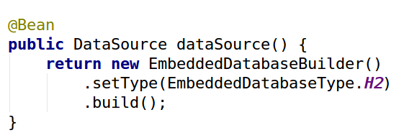
Conventions
Notes:
Spring Boot allows just adding h2 as a dependency, can override by providing specific properties, or a Bean of your own

Slide 29
Why Spring Boot?
Dependency Management
Stand-alone Spring Applications
Conventions
Production-ready features

Slide 30
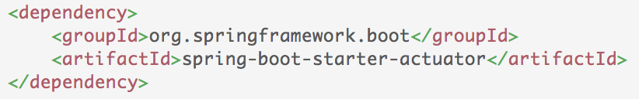
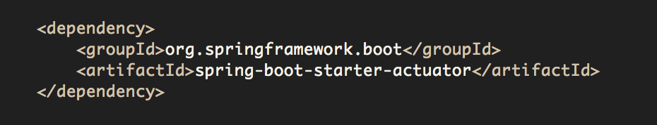
Actuator
Offers production-ready features such as monitoring and metrics to improve operator efficiency

Slide 31
Actuator
Actuator Services are exposed through
HTTP endpoints
shell interface
JMX Beans
REST endpoint (Spring MVC App)
shell interface
JMX
beans
Spring Boot Application
Actuator

Slide 32
Types of Actuator Endpoints
Configuration
/beans
/autoconfig
/env
/configprops
/controller
Metrics
/metrics
/trace
/dump
Miscellaneous
/shutdown
/info

Slide 33
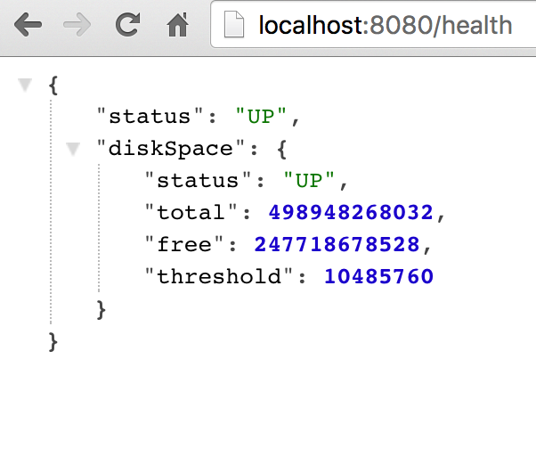
/health
Reports health metrics for the application
Each check returns a Health object
status
UP
DOWN
UNKONWN
OUT_OF_SERVICE
Plugin your own health definitions

Slide 34
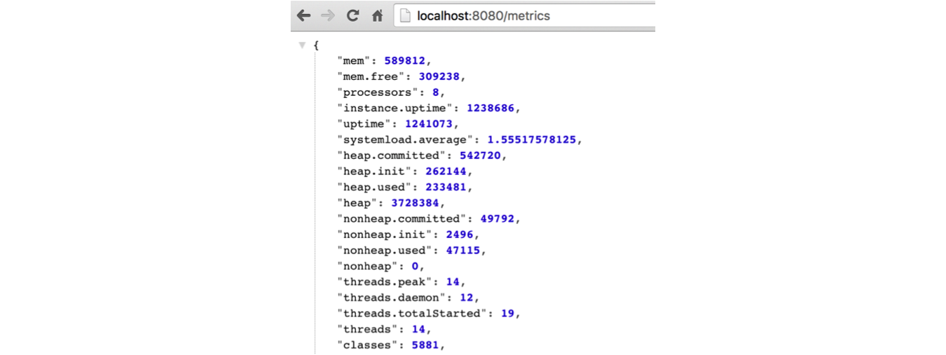
/metrics
Reports application metrics such as
Memory usage and
HTTP request counters

Slide 35
Agenda
Why Spring?
Why Spring Boot?
What’s New in Spring Boot 2.0

Slide 36
What’s New in Spring Boot 2.0
Reactive
New Base Line
Gradle Plugin
Security Simplifications
Rewrite of Actuator
Kotlin
Notes:
Reactive - WebFlux and WebFlux.fn, Reactive Spring Data, Reactive Security, on Netty
Needs Java 8, Spring 5, Tomcat 8.5, Hibernate 5.2, Gradle 3.4
Gradle - To create fat jars, bootRepackage Gradle’s task gets replaced with bootJar and bootWar to build jars and wars respectively. Dependency Management not applied automatically (dependency lock)
Just adds the EnableWebSecurity vs trying to guess what users want
Rewrite of Actuator
Kotlin
Animated ASCII Art

Slide 37
What’s New in Spring Boot 2.0
Notes:
Reactive - WebFlux and WebFlux.fn, Reactive Spring Data, Reactive Security, on Netty
Needs Java 8, Spring 5, Tomcat 8.5, Hibernate 5.2, Gradle 3.4
Gradle - To create fat jars, bootRepackage Gradle’s task gets replaced with bootJar and bootWar to build jars and wars respectively. Dependency Management not applied automatically (dependency lock)
Just adds the EnableWebSecurity vs trying to guess what users want
Rewrite of Actuator
Kotlin
Animated ASCII Art

Slide 38


Thank You

